Slide 1

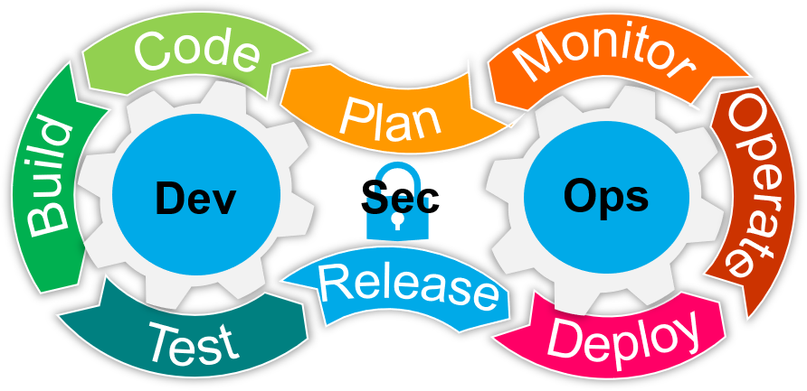
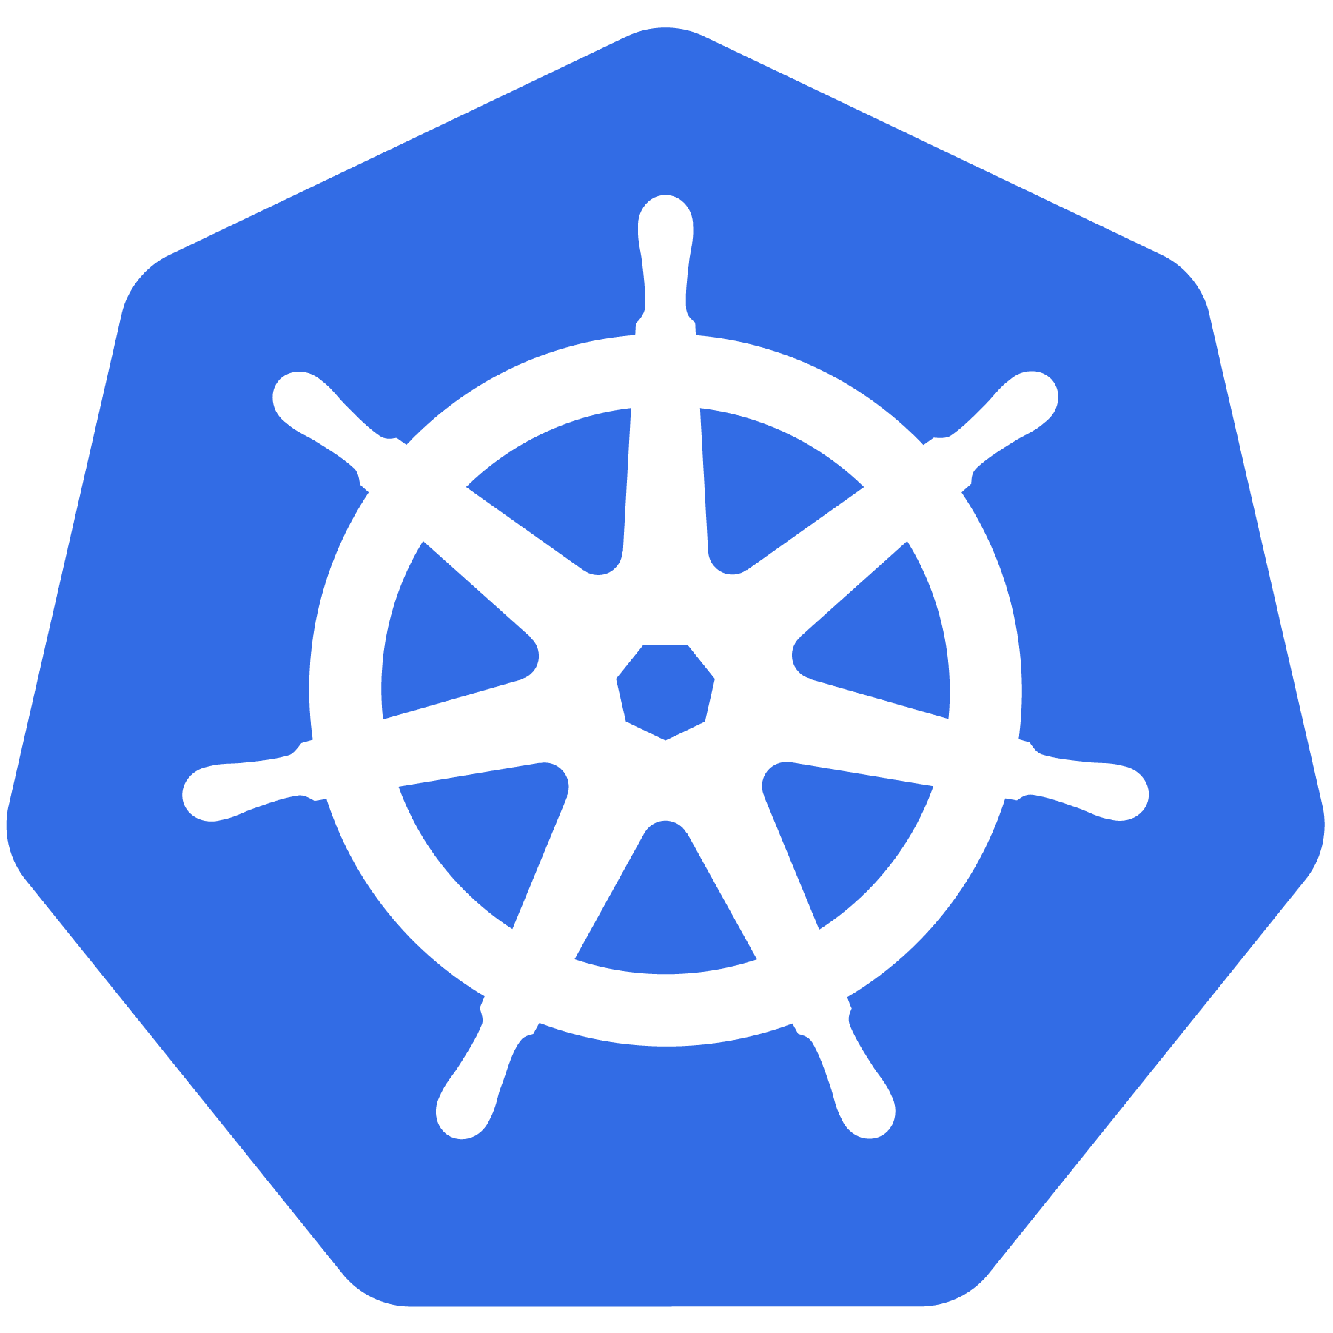

Getting Started with Containerization
Presenter : Chitti Babu Challa

Slide 2
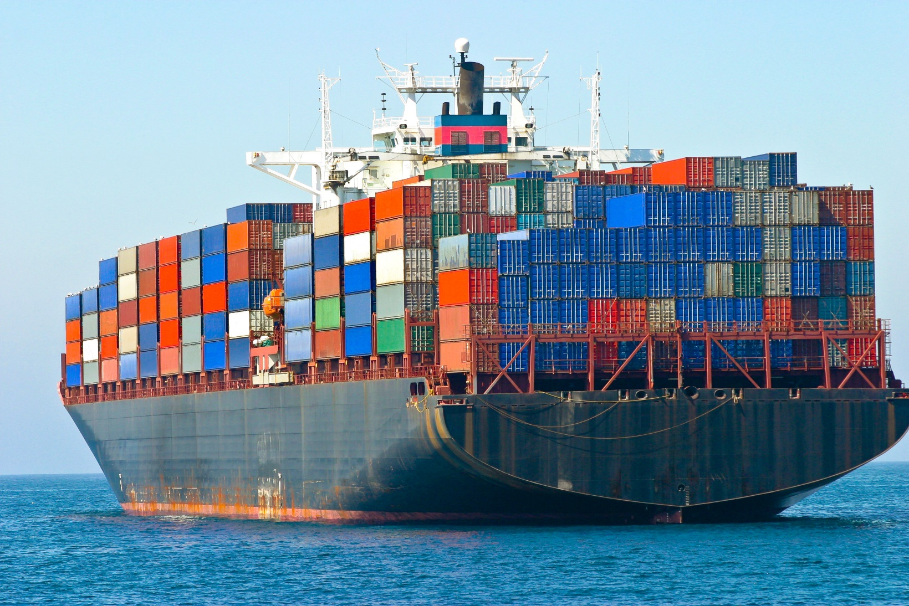
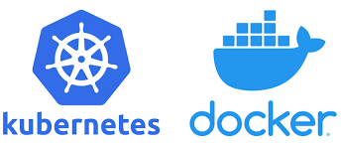
Getting Started with Containerization
What is Docker
Need and Usage of Containers
Container Images
Docker Compose - The Multi-Container Tool
Container Registries
What and Why Kubernetes
Microservices Architecture
Deploying Voting App on Kubernetes-Demo
Kubernetes on AKS(AWS)- Introduction-Demo

Slide 3
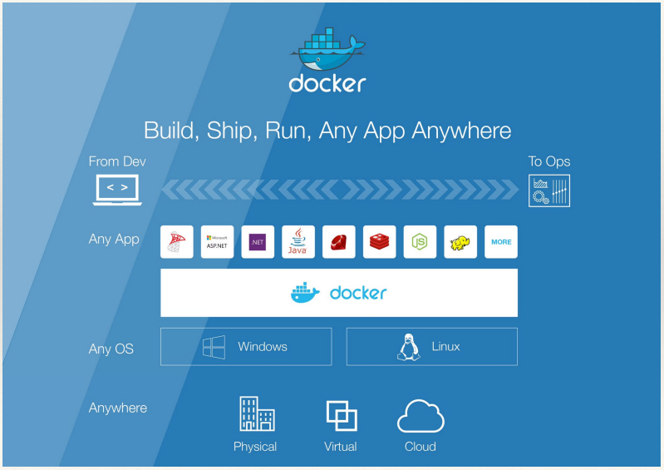
Why Docker?
Build: Package your application in a container
Ship: Move that container from one machine to another.
Run: Execute Container (i.e., Your Application)
Notes:
Build, Ship, Run – Any App Anywhere – that’s Docker’s slogan
But, what does it mean?
What it essentially boils down to is that developers can choose whatever language or components they want to build their application – .Net, ASP, Java, Ruby, Redis, etc across both the Linux and Windows ecosystem. They are assured that whatever the code up, will run wherever the Ops team chooses to deploy it – Physical, virtual, or cloud – it makes no difference to Docker.
An application written on a developers laptop will run exactly the same on the largest bare metal servers, in the cloud, even on a Raspberry Pi in my den.
Move applications seamlessly from dev to test to production.

Slide 4

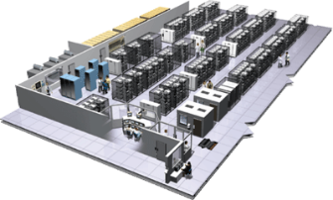

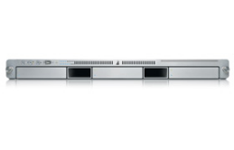
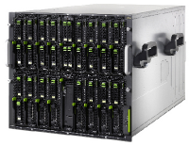

The New challenge of Distributed Apps
User DB
Static website
postgresql + pgv8 + v8
Queue
Analytics DB
nginx 1.5 + modsecurity + openssl + bootstrap 2
Do services and apps interact appropriately?
Multiplicity of Stacks
Redis + redis-sentinel
hadoop + hive + thrift + OpenJDK
Background workers
Web frontend
Python 3.0 + celery + pyredis + libcurl + ffmpeg + libopencv + nodejs + phantomjs
Ruby + Rails + sass + Unicorn
API endpoint
Python 2.7 + Flask + pyredis + celery + psycopg + postgresql-client
Production Cluster
Development VM
Public Cloud
Multiplicity of hardware environments
QA server
Can I migrate smoothly and quickly?
Disaster recovery
Customer Data Center
Contributor’s laptop
Production Servers
Shipping Code is Damn too Hard

Slide 5
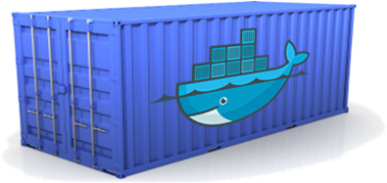
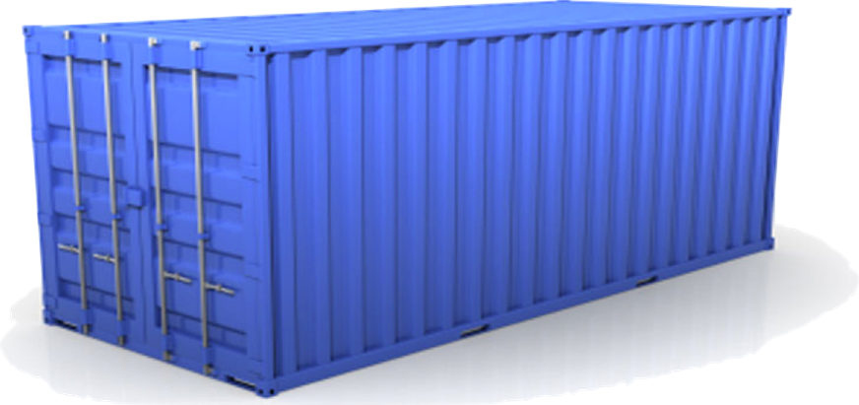
An effort to solve the Problem complexity
Static website
User DB
Web frontend
Queue
Analytics DB
Do services and apps interact appropriately?
Multiplicity of Stacks
An engine that enables any payload to be encapsulated as a lightweight, portable, self-sufficient container…
…that can be manipulated using standard operations and run consistently on virtually any hardware platform
Multiplicity of hardware environments
Can I migrate smoothly and quickly
Development VM
QA server
Customer Data Center
Public Cloud
Production Cluster
Contributor’s laptop

Slide 6
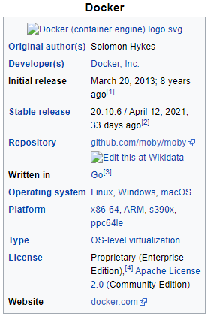
What is Docker?
Docker is an open-source project that automates the deployment of applications inside software containers .
It provides all necessary tools for create, deploy and run your applications by using containers.
Lightweight, secure platform
Simplify building, shipping, running apps
Runs natively on Linux or Windows Server
Can Run on Linux, Windows or Mac Development machines
What will Docker do for me
Docker is all about speed Deploy Faster
Develop Faster Update Faster
Build Faster Recover Faster
Test Faster
Source: https://en.wikipedia.org/wiki/Docker_(software)

Slide 7
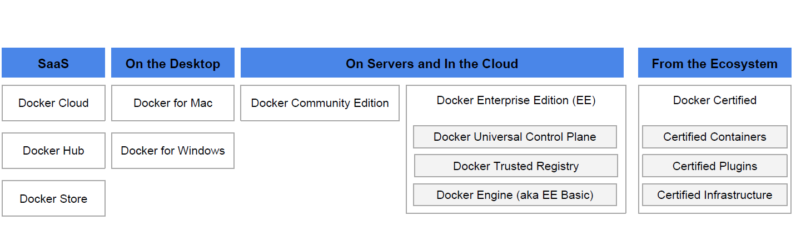
Docker Product Offerings
Notes:
Docker Community (free) vs. Docker Enterprise (Paid)
Old Name “EE” = Enterprise Edition (same thing)
Windows Server 2016 comes with Enterprise Basic
Linux servers are a target for Enterprise
Developers and Sysadmins use Community locally

Slide 8
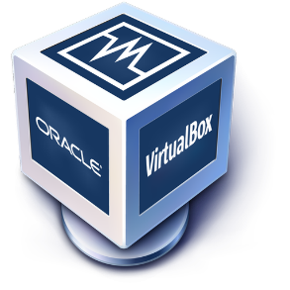
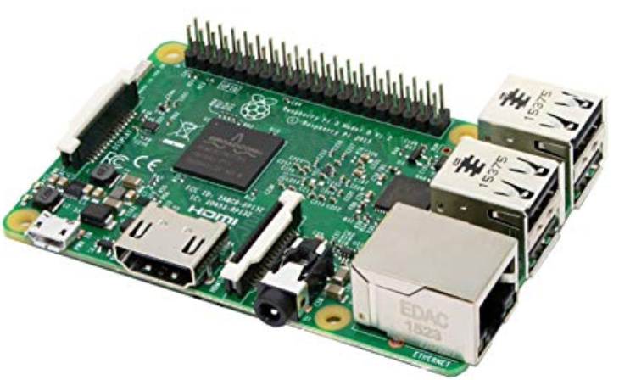
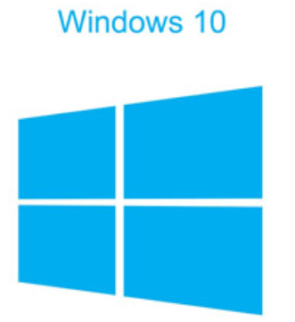
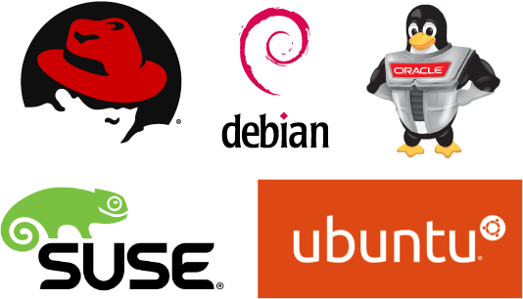

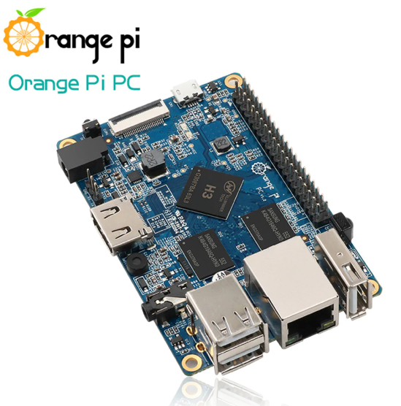
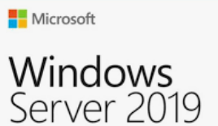
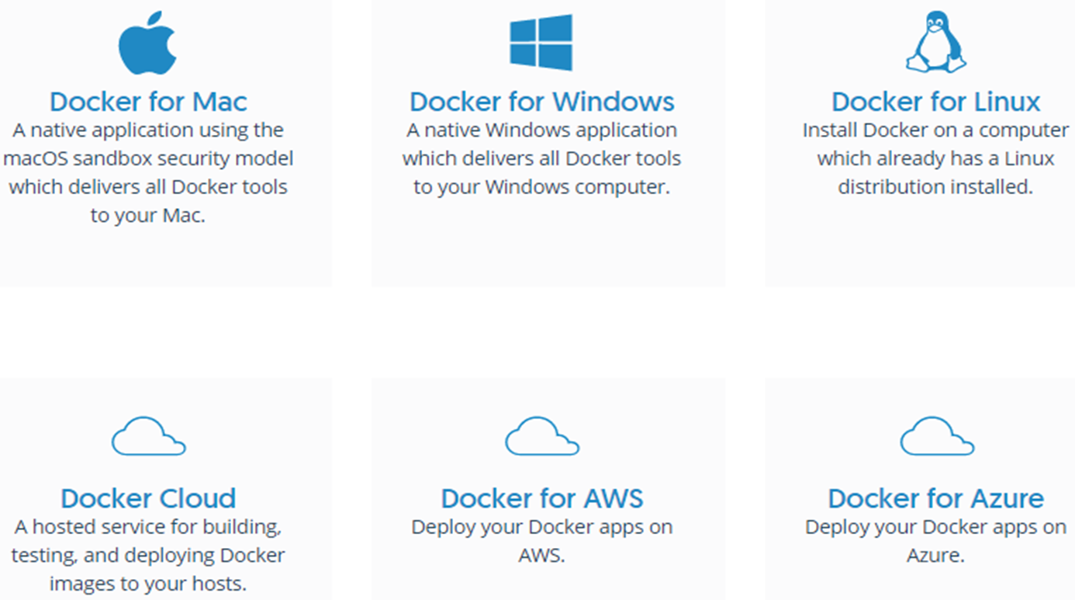




Today Docker Runs on
Docker Installation – on Platforms
Install it from - https://docs.docker.com/get-docker/

Slide 9
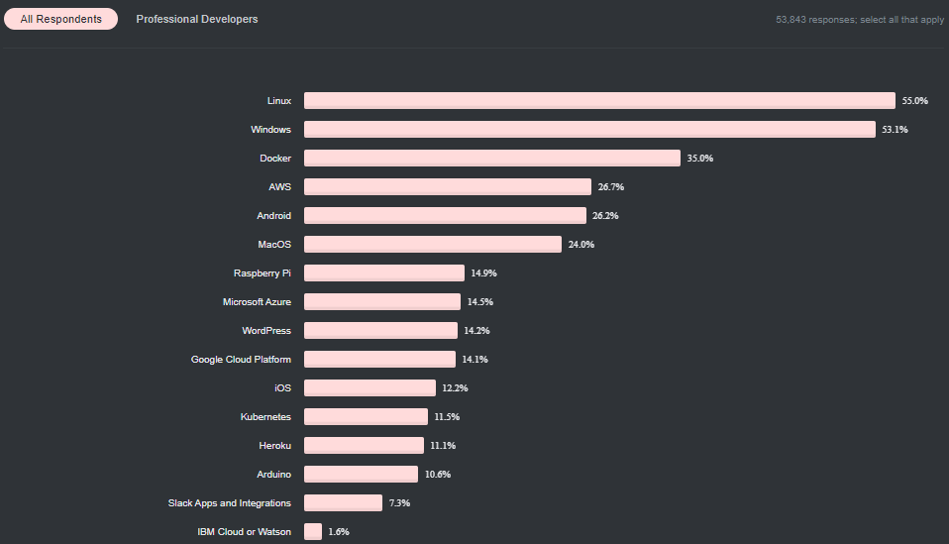
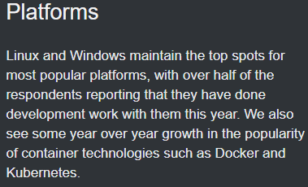
Docker Stats
Docker is becoming a core competency for operators and developers across the industry- in the 2020 stack Overflow survey, Docker polled as people’s number one “most wanted” technology (https://insights.stackoverflow.com/survey/2020#technology-platforms)

Slide 10
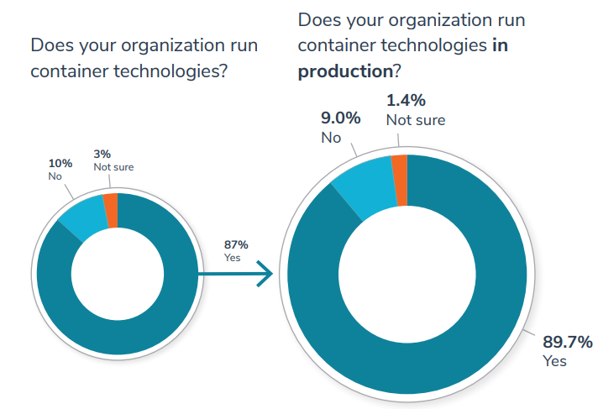
Container adoption continues to grow year over year
This year, over 87% of respondents said that they were running container technologies—a remarkable increase from two years ago year, when just over half (55%) said they were running container technologies. This percentage is also up from 80% in 2018. Of those running applications in containers, nearly 90% are running them in production, up from 84% last year.
Not only are more companies running containerized applications, they are running a greater percentage of their applications in containers with 71% of respondents reporting that they are running at least 40% of their application portfolio in containers. This is up from 65% in 2018 and 40% in 2017.
Source: 2019 Container Adoption Survey - Presented by Portworx and Aqua Security
Notes:
So why do companies look at Docker?
Software is the lifeblood of organizations, whether automating internal processes or creating unique and engaging ways for the services to customer, every company considers themselves a “digital” or “tech” company to some extent. To that end, many organizations like yours are looking at strategies to…
- Modernize their apps (refactor or build cloud native apps)
- Adopt microservices / distributed app architectures
- migrate to containers
- Cloud adoption, migration or multi cloud approaches
But getting there isn’t always easy because you have legacy applications and environment to take care while you try to do new innovative things. Organizational processes might not be ready to go all in and how do you avoid the worries of just getting locked into a cloud from datacenter?

Slide 11
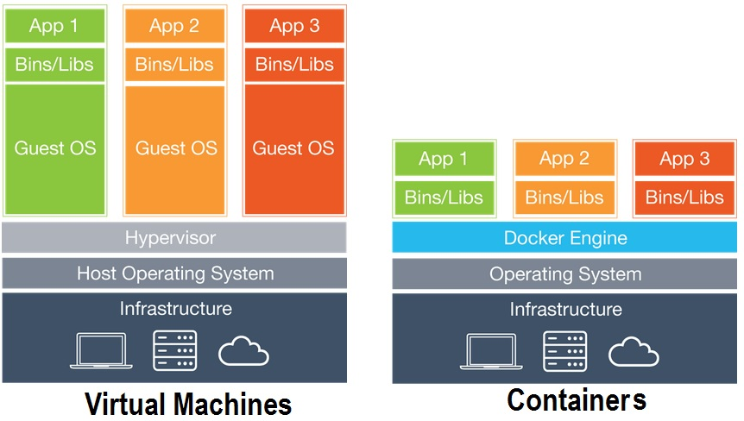
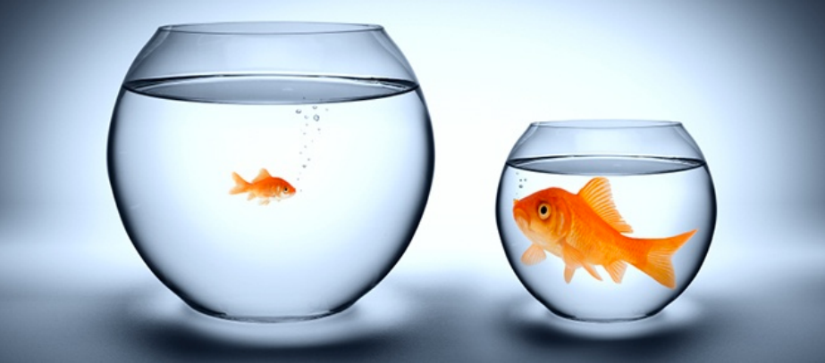
VMs vs Docker Containers
The main difference between containers and VMs is in their architectural approach.
Containers are isolated,
but share OS and, where
appropriate, bins/libraries
Virtual machines (VMs) are an abstraction of physical hardware turning one server into many servers. The hypervisor allows multiple VMs to run on a single machine. Each VM includes a full copy of an operating system, the application, necessary binaries and libraries - taking up tens of GBs. VMs can also be slow to boot.
Containers are an abstraction at the app layer that packages code and dependencies together. Multiple containers can run on the same machine and share the OS kernel with other containers, each running as isolated processes in user space. Containers take up less space than VMs (container images are typically tens of MBs in size), can handle more applications and require fewer VMs and Operating systems.
…result is significantly faster deployment, much less overhead, easier migration, faster restart
Notes:
Benefits:
Containers are more lightweight.
No need for a guest OS.
Rapid Development- it can create a container for every process and even does not boot an OS
Less resources.
Greater portability
Docker works well as part of its pipelines along with tools such as Travis, Jenkins, AWS, Azure etc.,
Security - Docker makes sure that applications that are running on containers are completely segregated and isolated from each other, from a security point of view, by granting complete control over traffic flow and management.

Slide 12
Why are Docker Containers lightweight ?
VMs
Containers
App
A
App
A
App
A’
App
A
App
A
App Δ
Bins/
Libs
Bins/
Libs
Bins/
Libs
Bins/
Libs
Bins/
Guest
OS
Guest
OS
Guest
OS
Guest
OS
Original App
(No OS to take
up space, resources,
or require restart)
Copy of
App
No OS. Can
Share bins/libs
Modified App
Copy on write capabilities allow
us to only save the diffs
Between container A and container, A’
VMs
Every app, every copy of an
app, and every slight modification
of the app requires a new virtual server

Slide 13
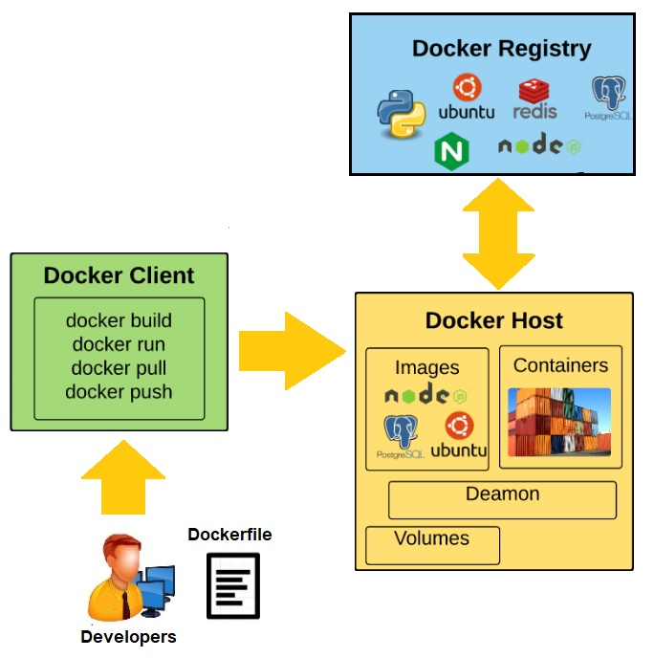
Docker Components
Docker is composed of six different components namely:
Docker Client;
Docker Daemon;
Docker Images;
Docker Registries;
Containers
Docker Engine
Notes:
Docker Client: This is the CLI (Command Line Interface) tool used to configure and interact with Docker. Whenever developers or users use the commands like docker run the client sends these commands to Docker daemon (dockerd) which carries them out. The docker command uses the Docker API and the Docker client can communicate with more than one daemon.
Docker Daemon: This is the Docker server which runs as the daemon. This daemon listens to API requests and manages Docker objects (images, containers, networks, and volumes). A daemon can also communicate with other daemons to manage Docker services.
Docker file: Used for building images
Image
The static component that represents a on-running application
Containers are derived from images
images contain EVERYTHING an application needs to run
Should always be built via a Dockerfile (which we’ll talk about in a bit later)
Containers:
The standard unit in which the application service resides
Package app and dependencies together
Isolated from other containers
One container per app / service
Docker Registries:
The service that store, distributes and manages container images
Receives commands from Docker Client via Engine
Access control with public(DockerHub), private repos
Docker Engine:
The program that creates, ships and runs containers
Deployable on any physical or vm host locally, in datacenters or cloud
Communicates with Docker Hub

Slide 14
What are the Basics of the Docker Systems ?
Container A
Docker
Container
Image Registry
Push
Search
Pull
Source Code Repository
Run
Build
Dockerfile
For
A
Container A
Container B
Container C
Docker
Docker Engine
Host 1 OS (Linux)
Host 2 OS (Linux)

Slide 15
Changes and Updates to Docker System
Docker
Container
Image Registry
App
A
Push
App A’
Bins/
Libs
Bins/
Base
Container
Image
Container Mod A’
Container Mod A’’
App A’
Update
App
A’’
App
A
Bins/
Bins/
Libs
Bins/
Libs
Bins/
Docker Engine
Docker Engine
Host is now running A’’
Host running A wants to upgrade to A’’. Request's update. Gets only diffs

Slide 16
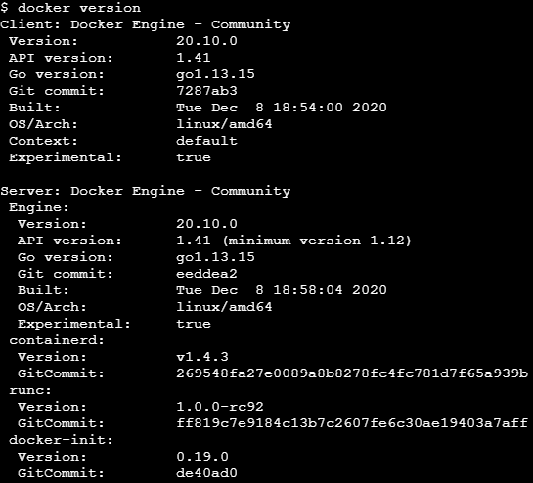
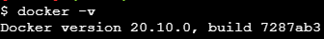
How to find Docker version
$ docker version
$ docker -v

Slide 17
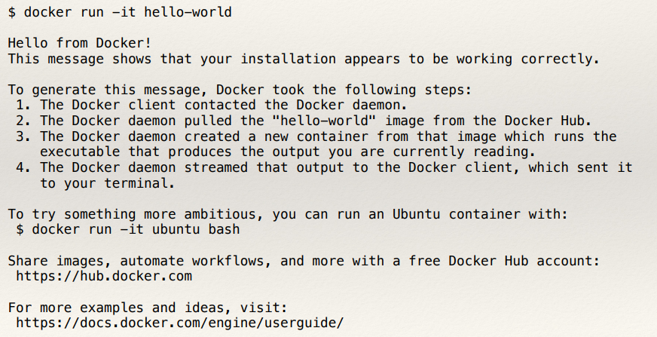
How to do “Hello World” in Docker
$ docker run -it hello-world

Slide 18
Dockerfile – Methods of Building Images
Commit changes from a container as a new image
Build from a Dockerfile
Import a tarball into Docker as a standalone base layer
Three Ways
Interactive building
Building from a Docker File
Base Image (Disk)
Base Image (Disk)
Run
Load
Run the
Installation
procedure
Container (Memory)
Dockerfile
Commit
Build
New Image (Disk)
New Image (Disk)

Slide 19

Docker Commit
$ docker commit – Command saves changes in container as a new image syntax
$ docker commit [options] [container ID] [repository:tag]
Repository name should be based on username/application
Can reference the container with container name instead of ID
Save the container with ID of 3c2dg5892a12 as a new image in the repository cbabu85/myapplication . Tag the image as 1.0
$docker commit 3c2dg5892a12 cbabu85/myapplication:1.0

Slide 20
Interactive Building Example : vim and curl
$ docker run -t -i ubuntu:14.04
root@2a896c8cdd83:/# apt-get install -y curl
root@2a896c8cdd83:/# apt-get install -y vim
root@2a896c8cdd83:/# exit
$ docker commit –m “test” 2a896c8cdd83 cbabu85/test:1.0

Slide 21
Intro to Dockerfile
A Dockerfile is a configuration file that contains instructions for building a Docker image
Provides more efficient way to build images compared to docker commit
Easily fits into your development workflow and your continuous integration and development process
Notes:
A Dockerfile describes how to build a docker image (using the ‘docker build’ command). The commands in the file are a mix of commands you’d actually run to install an application locally and specific keywords that tell Docker what to do (RUN a command COPY a file, etc).
An important point about Dockefiles is that they can live with your source code, and be versioned by your version control system. This means Docker images are 100% reproducible. This is another area where VMs and Containers can be different – many times VMs are hand built, and if you lose your golden image you’re out of luck.

Slide 22
Dockerfile Instructions
Instructions specify what to do when building the image
FROM instruction specifies what the base image should be
RUN instruction specifies a command to execute
Comments starts with “#”
# Example of a comment
FROM ubuntu : 19.04
RUN apt-get install vim
RUN apt-get install curl

Slide 23
Building a Docker Image from Dockerfile
<source-directory>
Dockerfile
files
.dockerignore
$docker build -t <image-name> <source-directory>

Slide 24
Multiple commands in a single RUN Instruction
Use shell syntax “&&” to combine multiple commands in a single RUN instruction
Commands will all be run in the same container and committed as a new image at the end
Reduces the number of image layers that are produced
# Example of a comment
FROM alpine : latest
RUN apk update && apk install –y\
curl \
vim\
openjdk-11-jdk

Slide 25
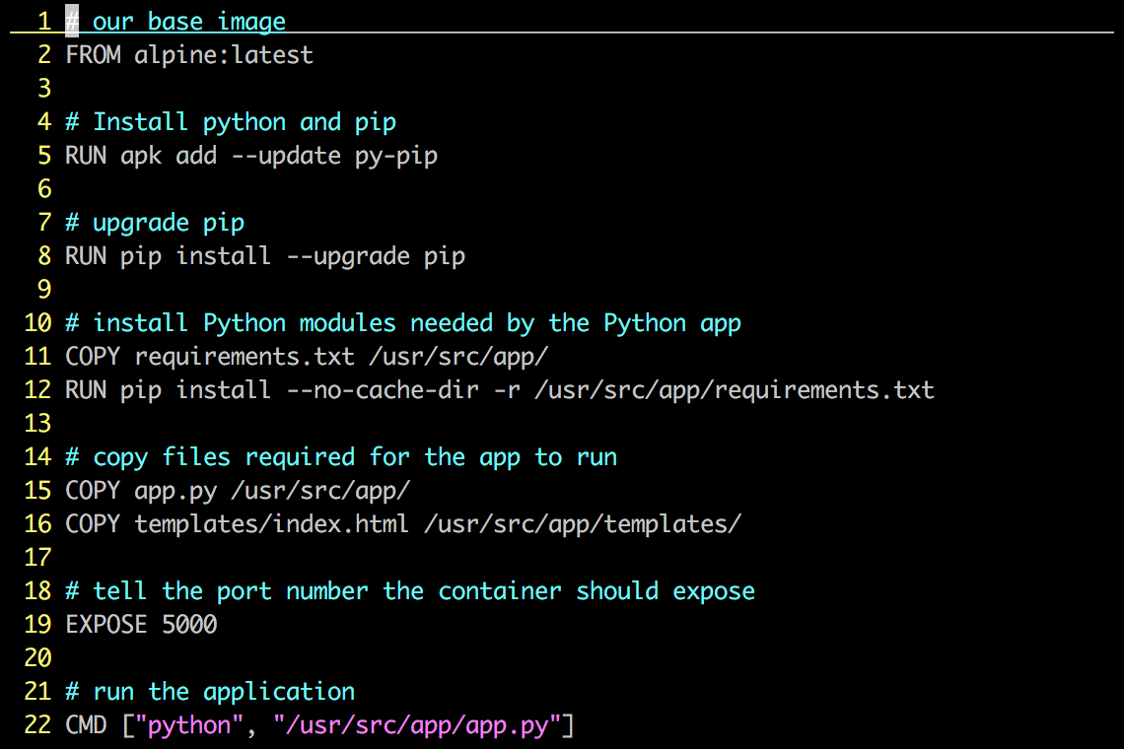
Dockerfile Example – Python Application
Instructions on how to build a Docker image
Looks very similar to “native” commands
Important to optimize your Dockerfile
Notes:
This Dockerfile builds a simple flask-based python webapp.
Let’s step through the Dockerfile line by line – note that when the Docker file is processed, all these commands are being run on the Docker image – not your local machine.
Line 1: Build this new Docker image based on the official Apline Linux base image
Line 5: Install Pythong and Pip (the python package manager)
Line 7: use Pip to ensure that Pip is the latest version
Line 11: Requirements.txt holds a list of libraries the app will need, and is used by pip to actually install the library. This line copies the file from your local machine into your Docker image
Line 12: Uses that file and Pip to install the requirements into the container
Line 15: Copy my application code (app.py) into the /usr/src/app directory of the image
Line 16: Copy our index.html file into the /usr/src/app/templates directory of the image
Line 19: The application communicates on port 5000, so we tell Docker to listen on that Port
Line 22: When the container starts up – we fire up Python and pass it out application code to start the app
Again, these steps are pretty much EXACTLY what you would do on a traditional machine to run this application, only here there are being used to create an Docker image.

Slide 26
Docker Container Architecture – Image Layers
…
Install Requirements
Copy Requirements
Upgrade Pip
Install Python and Pip
Alpine Linux
Kernel
Notes:
Each action in a docker file creates a new layer in the image.
If we visualize our earlier dockerfile example, you can see the changes in the image that each step created (we only show the first five commands). Images are built from the bottom up, so any change made by a subsequent step, is layered on top of the previous changes already made.
Image layers can be shared between different images. This means that the layers are not duplicated on your Docker host (or on the Registry when they’re pushed). Depending on the underlying filesystem each of these layers is represented by a directory on the Docker host.
You’ll notice if you ever look at a complicated dockerfile that authors will work to put as many commands into a single line by concatenating them together. This is to reduce the numbers of layers in an image.
When you do a docker run command, an additional read / write layer is added to the image. An important point is that even if you started 100 containers, all that is created is 100 Read / Write layers, and they all point back to the read only image on the host.

Slide 27
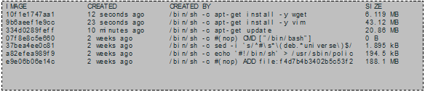
Viewing Image Layers and History
$ docker history command shows us the layers that make up an image
See when each layer was created, its size and the command that was run

Slide 28
MAINTAINER Instruction
Specifies who wrote the Dockerfile
Optional but best practice to include
Usually placed straight after FROM instruction
Example:
MAINTAINER Containerization Webinar <chittibabuc@virtusa.com>

Slide 29
CMD Instruction
CMD defines a default command to execute when a container is created
Shell format and EXEC format
Can only be specified once in a Dockerfile
- If specified multiple times, the last CMD instruction is executed
can be overridden by the explicit argument when providing docker run command
Shell Format
CMD ping 127.0.0.1 –c 30
EXEC format
CMD [“ping” , “127.0.0.1” , “-c” , “30”]

Slide 30
ENTRYPOINT Instruction
Defines the command that will run when a container is executed
Run time arguments and CMD instruction are passed as parameters to ENTRYPOINT instruction
Shell and EXEC format
Containers essentially runs as an executable
ENTRYPOINT [“PING”]

Slide 31
Overridding ENTRYPOINT Instruction
Specifying parameter during docker run will result in your parameters being used as arguments for the ENTRY POINT Command
To override the command specified by ENTRYPOINT, use the –entrypoint flag
Useful for troubleshooting your images
Run a container using the image “myimage” and specify to run a bash terminal instead of the program specified in the image ENTRYPOINT instruction
$ docker run –it –entrypoint bash myimage

Slide 32
Mount a Volume
Volumes can be mounted when running a container
Use the –v option on docker run command and specify the name of the volume and the mount path
Syntax--> docker run –v <name>:<path> ..
Path is the container folder where you want to mount the volume
Can mount multiple volumes by using the –v option multiple times
Execute a new container and mount the volume test1 in the folder /new/test1
$ docker run –it –v test1:/new/test1 ubuntu : 19.04
Example of mounting multiple volumes
$ docker run –it –v test1:/new/test1 –v test2:/new/test2 ngnix

Slide 33
Some Docker Basic Commands
$ docker pull mikegcoleman/catweb:1.0 $ docker images $ docker run –d –p 5000:5000 –-name catweb mikegcoleman/catweb:latest $ docker ps -a $ docker stop catweb (or <container id>) $ docker rm catweb (or <container id>) $ docker rmi mikegcoleman/catweb:latest (or <image id>) $ docker build –t mikegcoleman/catweb:2.0 . $ docker push mikegcoleman/catweb:2.0
Notes:
Docker pull pulls an image from the registry to the local host. This example shows us pulling the 1.0 version of the Catweb image from the mikegcoleman repo on Docker Hub
Docker images will list all the images on your docker host
Docker run will start a new container. In this case we are instructing the docker engine to run the mikegcoleman/catweb image we pulled earlier -d tells docker It should start the application in detached mode (running in the backgorund) and –p 5000:5000 tells docker engine that any requests coming into port 5000 on the host should be directed to port 5000 on this container. –name catweb specifies a name for our running container. If you do not specify a name, Docker will generate one (and they can be pretty funny)
Docker ps shows runing containers. ps –a will show all containers, including ones that have been stopped
Docker stop stops a running container (but does not delete it). You can specify the container name (catweb in our example) or the container ID (every image and container are assigned a unique ID)
Docker rm removes the stopped container. if you specify rm –f you will force docker to remove container even if it’s running. again you can specify the name or ID
Docker rmi removes the specified image
Docker build will create a new image from a docker file. In this example we are creating an image called mikegcoleman/catweb and we’re tagging it with a 2.0 version number. The period says to build the image from the docker file in the current directory. You can explicitly specify a path to your dockerfile if you so choose
Docker push is the opposite of Docker – it pushes an image up to a registry. In this case we’re pushing our newly created docker image up on to hub.

Slide 34
Manage & Inspect Containers
$ docker create <Container ID> # creates a container but does not start it.
$ docker run <Container ID> # creates and starts a container.
$ docker stop <Container ID> # stops it.
$ docker start <Container ID> # will start it again.
$ docker restart <Container ID> # restarts a container.
$ docker rm <Container ID> # deletes a container.
$ docker kill <Container ID> # sends a SIGKILL to a container.
$ docker attach <Container ID> # will connect to a running container.
$ docker wait <Container ID> # blocks until container stops.
$ docker exec <Container ID> # runs a command in a running container.
$ docker ps <Container ID> # shows running containers.
$ docker inspect <Container ID> # info on a container (incl. IP address).
$ docker logs <Container ID> # gets logs from container.
$ docker events <Container ID> # gets events from container.
$ docker port <Container ID> # shows public facing port of container.
$ docker top <Container ID> # shows running processes in container.
$ docker diff <Container ID> # shows changed files in container's FS.
$ docker stats <Container ID> # shows metrics, memory, cpu, filsystem

Slide 35
Containers
# Run a container interactively
$ docker run -it --rm ubuntu
# Run a container in the background
$ docker run -d hadoop
# Publish container port 80 on a random port on the Host
$ docker run -p 80 nginx
# Publish container port 80 on port 8080 on the Host
$ docker run -p 8080:80 nginx
# Publish container port 80 on port 8080 on the localhost interface on the Host
$ docker run -p 127.0.0.1:8080:80 nginx
# Publish all EXPOSEd ports from the container on random ports on the Host
$ docker run -P nginx

Slide 36
Containers
# Limit the amount of memory
$ docker run -m 256m yourapp
# Limit the number of shares of the CPU this process uses (out of 1024)
$ docker run --cpu-shares 512 mypp
# Change the user for the process to www instead of root (good for security)
$ docker run -u=www nginx

Slide 37
Volumes
# Start a new nginx container with /var/log as a volume (created)
$ docker run -v /var/log nginx
# Start a new nginx container with /var/log as a volume mapped to /tmp on Host
$ docker run -v /tmp:/var/log nginx
# Start a db container
$ docker run -v /var/lib/postgresql/data --name mydb postgres
# Start a backup container with the volumes taken from the mydb container
$ docker run --volumes-from mydb backup

Slide 38
Docker Ecosystem
Docker Engine or “Docker” creates and runs Docker containers. Install Docker on Ubuntu, Mac OS X, or Windows.
Docker Hub Public registry service for managing images.
Docker Registry provides open source Docker image distribution.
Docker Swarm used to host clustering and container scheduling.
Kitematic is the desktop GUI for Docker.

Slide 39
Docker Ecosystem
Docker UI is a web responsive GUI to administrate Docker
Docker Trusted Registry (DTR) supplies a private dedicated image registry.
Docker Machine automates container provisioning on your network or in the cloud. Install machine on Windows, Mac OS X, or Linux.
Docker Compose defines multi-container applications. You can install Docker Compose on Ubuntu, Mac OS X, and other systems.

Slide 40
Start a Docker Registry
Running on localhost
1. Start your registry:
docker run -d -p 5000:5000 --restart=always --name registry registry:2
2. Get any image from the hub and tag it to point to your registry:
docker pull ubuntu && docker tag ubuntu localhost:5000/ubuntu
3. push it to your registry:
docker push localhost:5000/ubuntu
4. pull it back from your registry:
docker pull localhost:5000/ubuntu

Slide 41
Start a Docker Registry
Run the registry image
• docker container run -d -p 5000:5000 --name registry registry
Re-tag an existing image and push it to your new registry
• docker tag hello-world 127.0.0.1:5000/hello-world
• docker push 127.0.0.1:5000/hello-world
• Remove that image from local cache and pull it from new registry
• docker image remove hello-world
• docker image remove 127.0.0.1:5000/hello-world
• docker pull 127.0.0.1:5000/hello-world
• Re-create registry using a bind mount and see how it stores data
• docker container run -d -p 5000:5000 --name registry -v $(pwd)/
registry-data:/var/lib/registry registry

Slide 42
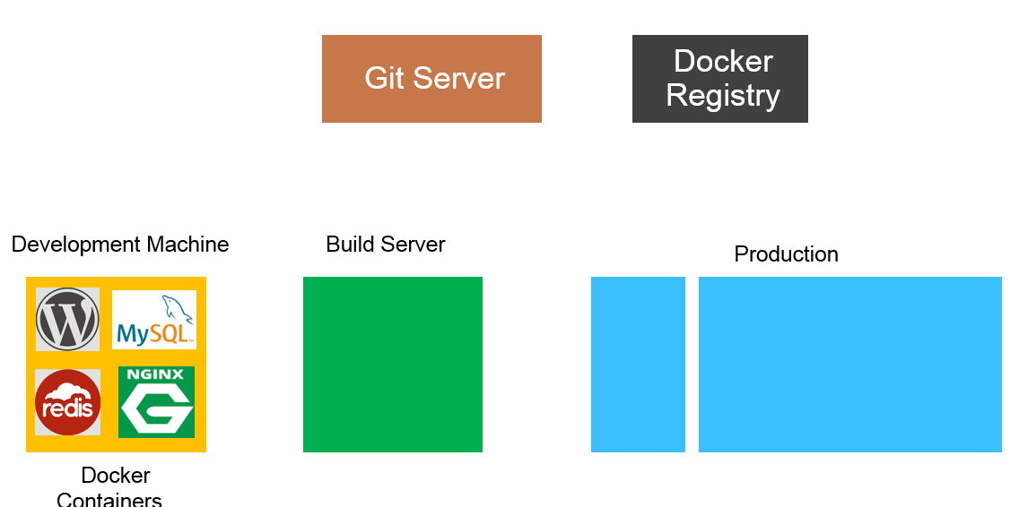

Traditional Software Development workflow ( Without Docker )

Slide 43
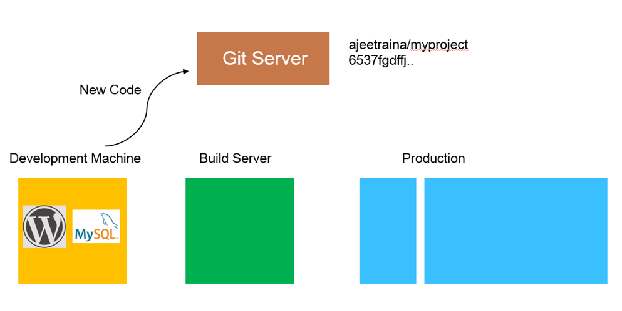
Traditional Software Development workflow ( Without Docker )
cbabu85/myproject
234fgdvjj..

Slide 44
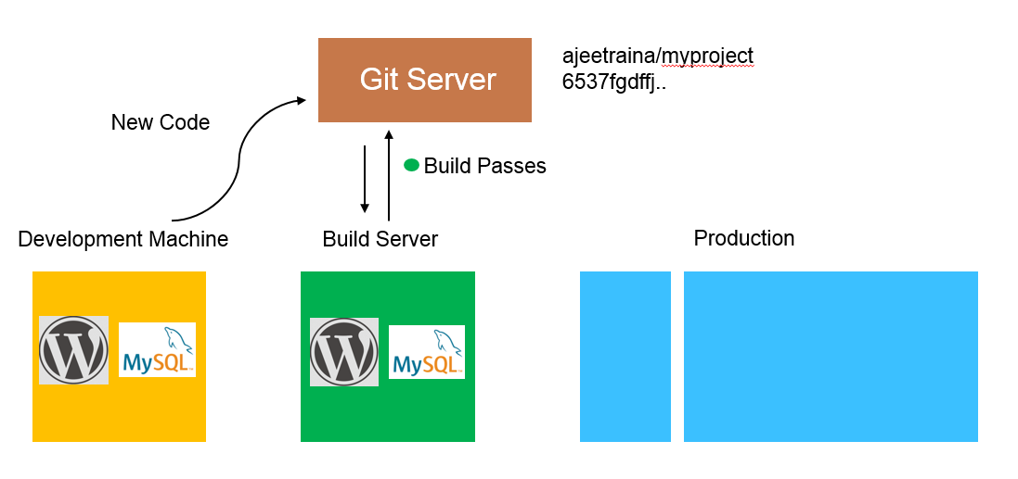
Traditional Software Development workflow ( Without Docker )
cbabu85/myproject
234fgdvjj..

Slide 45
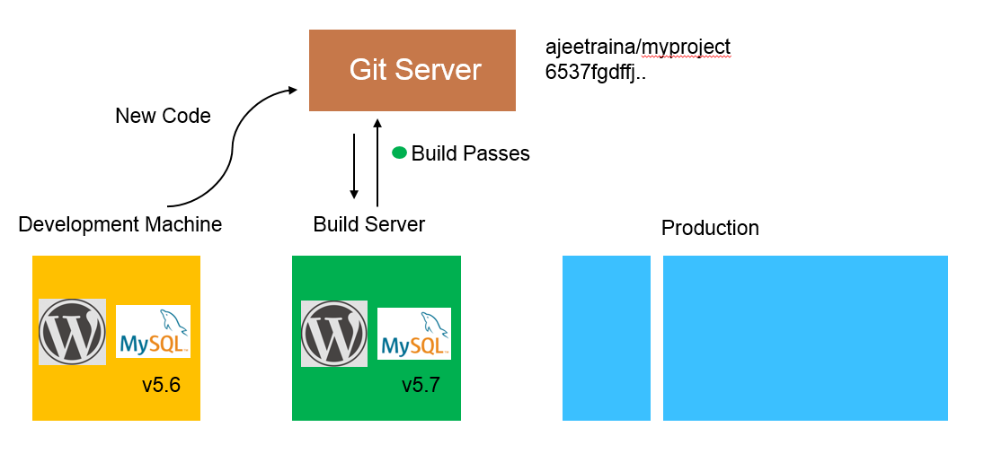
Traditional Software Development workflow ( Without Docker )
cbabu85/myproject
234fgdvjj..

Slide 46
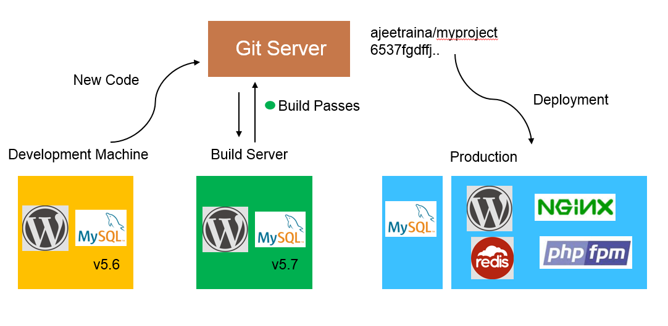
Traditional Software Development workflow ( Without Docker )
cbabu85/myproject
234fgdvjj..

Slide 47
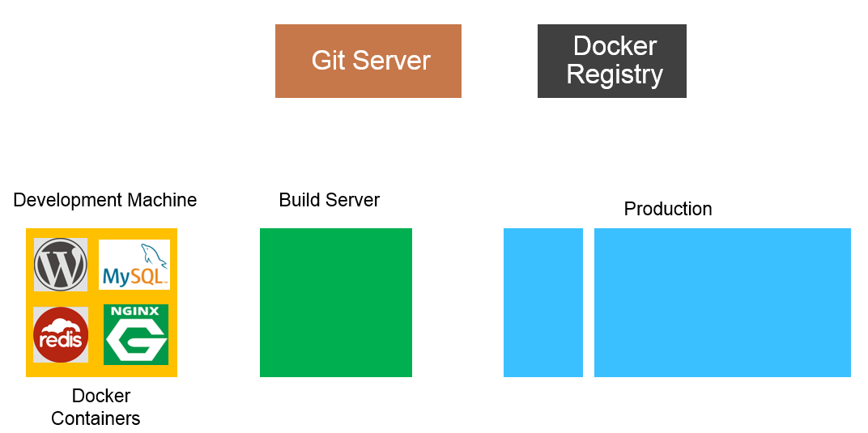
Traditional Software Development workflow ( With Docker )

Slide 48
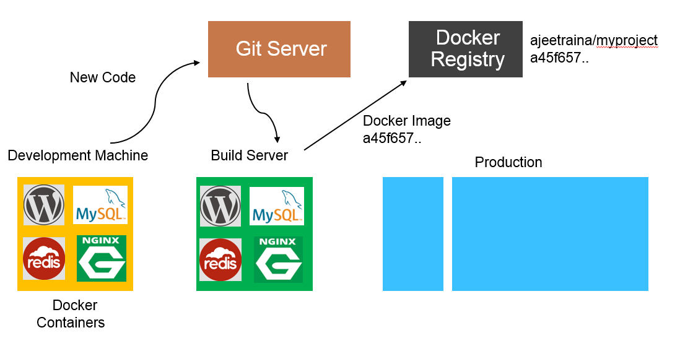
Traditional Software Development workflow ( With Docker )
cbabu85/myproject
234fgdvjj..

Slide 49
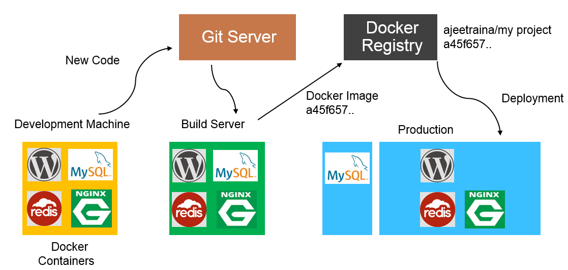
Traditional Software Development workflow ( With Docker )
cbabu85/myproject
234fgdvjj..

Slide 50
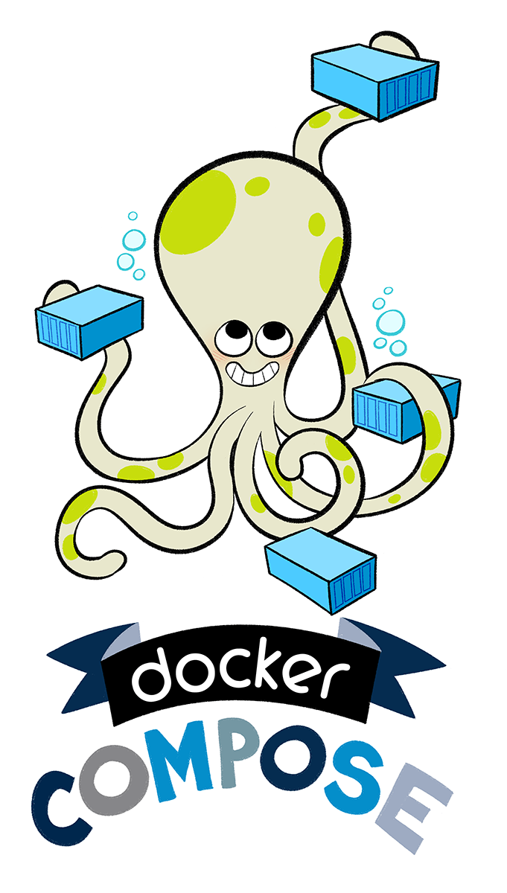
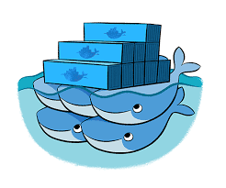
Docker Compose
Docker Compose is a tool for defining and running complex applications with Docker.
Define a multi-container application in a single file
Spin your application up in a single command
Steps to follow-
Step 1. Create a docker-compose.yml file (or docker-compose.yaml file)
Step 2. Execute “docker-compose up -d”
Step 3. Execute “docker-compose logs” from another shell (but from same dir)
Step 4. Execute “docker-compose down”
Notes:
Docker Compose is a tool for running multi-container applications on Docker defined using the Compose file format. A Compose file is used to define how the one or more containers that make up your application are configured. Once you have a Compose file, you can create and start your application with a single command: docker-compose up.

Slide 51
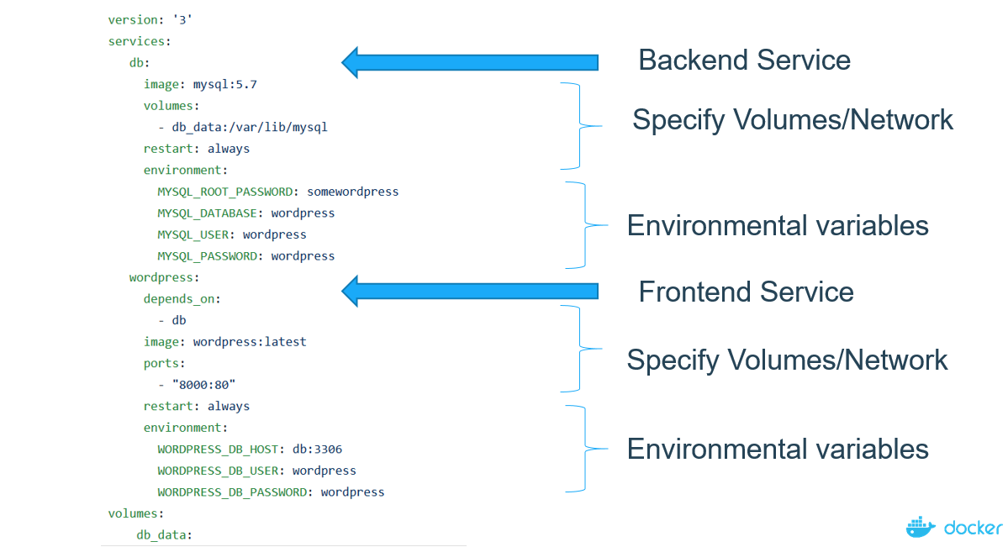
Docker Compose
Compose is a tool for defining and running multi-container Docker applications
Notes:
Docker Compose is a tool for running multi-container applications on Docker defined using the Compose file format. A Compose file is used to define how the one or more containers that make up your application are configured. Once you have a Compose file, you can create and start your application with a single command: docker-compose up.

Slide 52
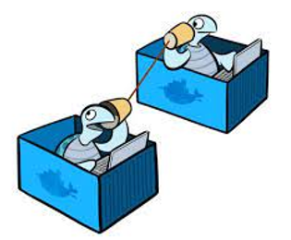
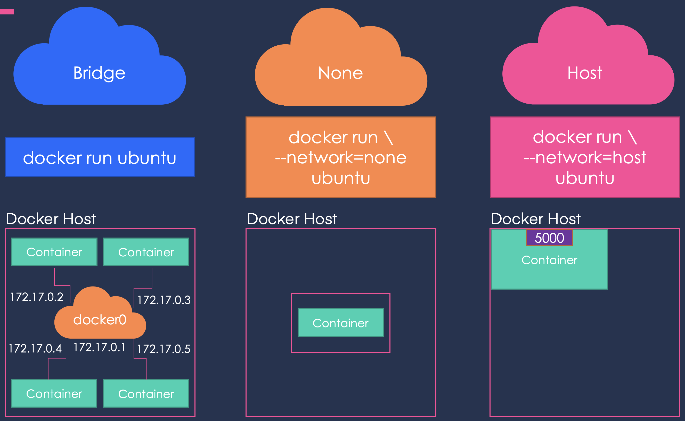
Docker Basic Networking
https://training.play-with-docker.com/docker-networking-hol/
When Docker is initially installed, three different Docker networks are configured – none, host and bridge. The none and host are important components of the Docker stack, and cannot be removed. The bridge network can be configured, known as the docker0 network.
Docker can be used for creating many networks. You can add containers to more than one network. A container that is attached to multiple networks can connect with the containers of these networks.
$ docker network command is the main command for configuring and managing container networks
$ docker network inspect command is used to view network configuration details
$ docker info command shows a lot of interesting information about a Docker installation
$ docker container run -it –net=mynetwork nginx command can be used for connecting to another network when you run the container:
Notes:
The Bridge network assigns IPs in the range of 172.17.x.x to the containers within it. To access these containers from outside you need to map the ports of these containers to the ports on the host.
Another automatically created network is Host. Selecting the Host network will remove any network isolation between the docker host and the containers. For instance, if you run a container on port 5000, it will be accessible on the same port on the docker host without any explicit port mapping. The only downside of this approach is that you can not use the same port twice for any container.
Finally, the None network keeps the container in complete isolation, i.e. they are not connected to any network or container.
The containers can reach each other using their names. This is made possible by an Embedded DNS which runs on the address 127.0.0.11.

Slide 53
Docker Containers Security
RULE #0 - Keep Host and Docker up to date
RULE #1 - Do not expose the Docker daemon socket (even to the containers)
RULE #2 - Set a user
RULE #3 - Limit capabilities (Grant only specific capabilities, needed by a container)
RULE #4 - Add –no-new-privileges flag
RULE #5 - Disable inter-container communication (--icc=false)
RULE #6 - Use Linux Security Module (seccomp, AppArmor, or SELinux)
RULE #7 - Limit resources (memory, CPU, file descriptors, processes, restarts)
RULE #8 - Set filesystem and volumes to read-only
RULE #9 - Use static analysis tools
RULE #10 - Set the logging level to at least INFO
Rule #11 - Lint the Dockerfile at build time
Source : https://cheatsheetseries.owasp.org/cheatsheets/Docker_Security_Cheat_Sheet.html
Notes:
In some cases customers are taking existing legacy applications and moving them directly from VMs into containers. This allows these applications to be migrated easily across different infrastructures. Additionally, in the case of Linux, you can run your application container based on an older version of Linux (Say RHEL6) while the Docker host is running the latest version.

Slide 54
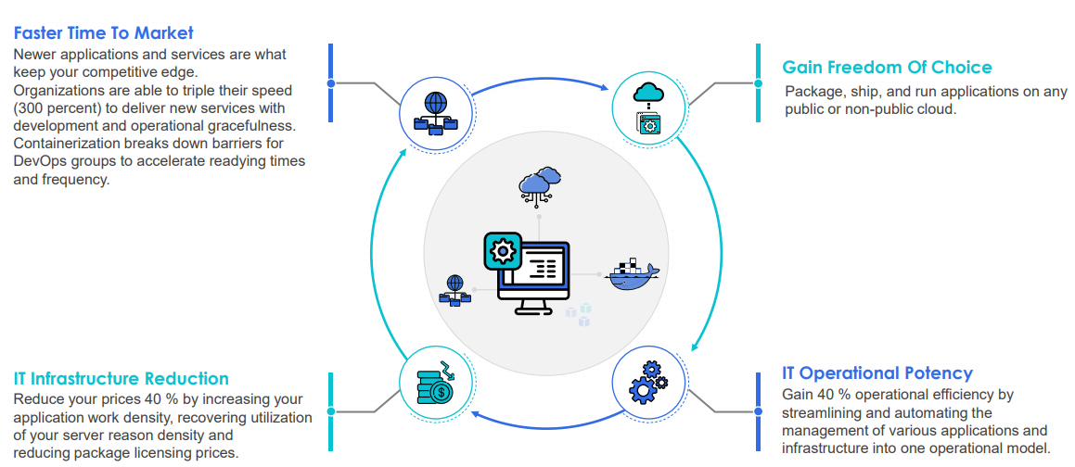
Why we need DockerContainers -Recap
Notes:
In some cases customers are taking existing legacy applications and moving them directly from VMs into containers. This allows these applications to be migrated easily across different infrastructures. Additionally, in the case of Linux, you can run your application container based on an older version of Linux (Say RHEL6) while the Docker host is running the latest version.

Slide 55
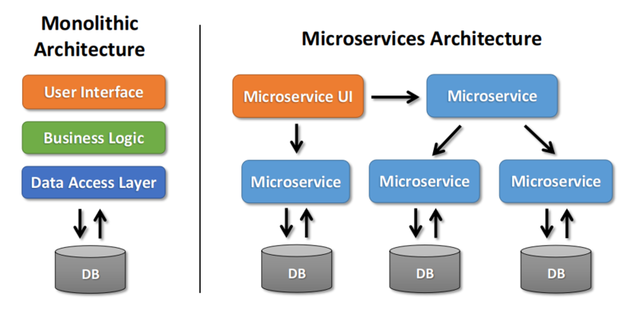
Microservices
A microservices architecture splits your application into multiple services that perform fine-grained functions and are part of your application as a whole. Each of your microservices will have a different logical function for your application.
Traditional applications have monolithic architectures where all your application’s components and functions are in a single instance; microservices break apart monolithic applications into smaller parts. The following diagram compares monolithic and microservices architectures.
Notes:
It used to be that you couldn’t talk about containers without talking about Microservices, but over the past year or so people have been looking at different ways to use containers along an application delivery continuum.
Containers are packages of your software that include everything that it needs to run, including code, dependencies, libraries, binaries, and more. Docker and Kubernetes are the most popular frameworks to orchestrate multiple containers in enterprise environments. Compared to virtual machines (VMs), containers share the operating system kernel instead of having a full copy of it, such as making multiple VMs in a single host. Although it’s possible to put your microservices into multiple VMs, you would typically use containers in this case since they take up less space and are faster to boot up.

Slide 56
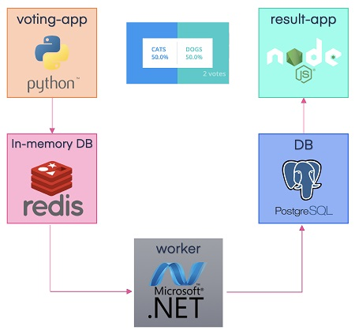
Microservices use case
This is a microservices application consisting of 5 microservices. The 5 microservices are described below:
Voting-app: Python front-end web app which lets you vote between two options
Redis: Redis queue which collects new votes
Worker: .NET Core which consumes votes and stores them in…
DB: Postgres database backed by a Docker volume
Result: Node.js web app which shows the results of the voting in real-time
Microservices using docker demo - Click -
Notes:
In a nutshell, users vote at the voting-app endpoint and you can view the results at a result-app endpoint. Both voting-app and result-app run on different ports.

Slide 57
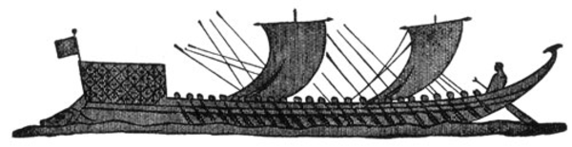
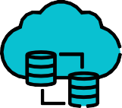
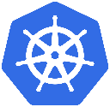



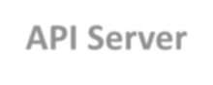




















What is Kubernetes
Kubernetes
Kubernetes, designed by Google and currently maintained by the Cloud Native Computing Foundation, is an open-source container-orchestration system. It helps in automating application deployment, scaling, and management
Worker Nodes
Control Plane
Kubelet
External
Requests
API Server
app
Service
app
Container Runtime
etcd
Kubelet
Container Runtime
app
Service
app
Scheduling
Kubernetes - Greek for “pilot” or
“Helmsman of a ship”
Service Discovery
Kubelet
Container Runtime
app
Service
app
Load Balancing
Notes:
There’s a phrase called Google-scale. This was developed out of a need to scale large container applications across Google-scale infrastructure
borg is the man behind the curtain managing everything in google
Kubernetes is loosely coupled, meaning that all the components have little knowledge of each other and function independently.
This makes them easy to replace and integrate with a wide variety of systems

Slide 58
Self Healing
Kubernetes will ALWAYS try and steer the cluster to its desired state.
Me: “I want 3 healthy instances of redis to always be running.”
Kubernetes: “Okay, I’ll ensure there are always 3 instances up and running.”
Kubernetes: “Oh look, one has died. I’m going to attempt to spin up a new one.”
Notes:
The instance will have a new IP and likely be on a different host, but Kubernetes gives the primitives for us to ‘not care’ about that.

Slide 59


Project Stats
Over 55,000 stars on Github
2000+ Contributors to K8s Core
Most discussed Repository by a large margin
70,000+ users in Slack Team
Notes:
Very active project
49k starts on github
2000+ contributors to main core repo
most discussed repo on github
massive slack team with 60k+ users

Slide 60

Why Organization Should use Kubernetes?
Notes:
When in production, many might require hundreds to thousands of separate containers in production.
This is where container runtime environments such as Docker benefit from the use of other tools to orchestrate or manage all the containers in operation.
One of the most popular tools for this purpose is Kubernetes, a container orchestrator that recognizes multiple container runtime environments, including Docker.
Kubernetes orchestrates the operation of multiple containers in harmony together. It manages areas like the use of underlying infrastructure resources for containerized applications such as the amount of compute, network, and storage resources required. Orchestration tools like Kubernetes make it easier to automate and scale container-based workloads for live production environments.

Slide 61

Orchestrator Options
Docker Swarm – integrated in docker container platform
Kubernetes – open-source, product of CNCF
Apache Mesos – cluster management tool, with container orchestration being only one of the things it can do, originally through a plugin called Marathon
Notes:
Kubernetes -
Major features include built-in auto-scaling, load balancing, volume management, and secrets management. In addition, there is a web UI to help with managing and troubleshooting the cluster. With these features included, Kubernetes often requires less third-party software than Swarm or Mesos.
Swarm-
Swarm does not yet support native auto-scaling or external load balancing. Scaling must be done manually or through third-party solutions.
Mesos-
Mesos can have multiple masters which use Zookeeper to keep track of the cluster state amongst the masters and form a high-availability cluster which is difficult to manage

Slide 62

















Kubernetes Components
Kubernetes Control Plane
CLOUD
Kube-controller Manager
Cloud-controller Manager
Kube-api-server
Kubelet
Kubelet
Kubelet
Kube-proxy
Kube-proxy
Kube-proxy
etcd
Kube-scheduler
Kubernetes Nodes
Notes:
Control Plane -
The control plane is the system that maintains a record of all Kubernetes objects. It continuously manages object states, responding to changes in the cluster
Kube-apiserver
Gate keeper for everything in kubernetes
EVERYTHING interacts with kubernetes through the apiserver
Etcd
Distributed storage back end for kubernetes
The apiserver is the only thing that talks to it
Kube-controller-manager
The home of the core controllers
kube-scheduler
handes placement
Kubernetes Nodes
Kubelet
Agent running on every node, including the control plane
Kube-proxy
The network ‘plumber’ for Kubernetes services
Enables in-cluster load-balancing and service discovery
Container Runtime Engine
The containerizer itself - typically docker

Slide 63





What is Kubelet ?
API Server
Kubectl
POD
Node
Master
Resource Definition (Pod, Etc)
Docker
Kubelet
The Kubelet is the primary “node agent” that runs on every node.
Kubectl is a instruction tool for controlling Kubernetes clusters. Kubectl looks for a file named config within the $HOME/. ... For details regarding every command, together with all the supported flags and subcommands, see the kubectl reference documentation.
Notes:
The kubelet works in terms of a PodSpec. A PodSpec may be a YAML or JSON object that describes a pod. The kubelet takes a group of PodSpecs that ar provided through numerous mechanisms (primarily through the apiserver) and ensures that the containers delineate in those PodSpecs ar running and healthy. The kubelet doesn’t manage containers that weren't created by Kubernetes

Slide 64
Kubernetes In A Browser
Try http://play-with-k8s.com or katacoda.com in browser
• Easy to get started
• Doesn't keep your environment

Slide 65

Workflow to run a container on Kubernetes

Slide 66
Kubernetes Container Abstractions
Pods: one or more containers running together on one Node
- Basic unit of deployment. Containers are always in pods
Controller: For creating/updating pods and other objects
- Many types of Controllers inc. Deployment, ReplicaSet, StatefulSet,
DaemonSet, Job, CronJob, etc.
Service: network endpoint to connect to a pod
Namespace: Filtered group of objects in cluster
- Secrets, ConfigMaps, and more

Slide 67

What is Nodes in Kubernetes?

Slide 68

Master Nodes in Kubernetes

Slide 69

Worker/Slave Nodes in Kubernetes

Slide 70



Pods
Atomic unit or smallest “unit of work”of Kubernetes.
Pods are one or MORE containers that share volumes, a network namespace, and are a part of a single context.
Pods Design
Pod Example
Notes:
Pod is a group of containers.
It is the smallest unit that can be scheduled to be deployed through K8s.
Normally a microservices is provided by this tightly coupled group of containers.
This groups of containers would share storage, Linux namespaces, cgroups, IP addresses.
These are co-located, hence share resources and are always scheduled together.
Created, destroyed and re-created on demand, based on the state of the server and the service itself.

Slide 71
Key Pod Container Attributes
name - The name of the container
image - The container image
ports - array of ports to expose. Can be granted a friendly name and protocol may be specified
env - array of environment variables
command - Entrypoint array (equiv to Docker ENTRYPOINT)
args - Arguments to pass to the command (equiv to Docker CMD)
Container
name: nginx
image: nginx:stable-alpine
ports:
- containerPort: 80
name: http
protocol: TCP
env:
- name: MYVAR
value: isAwesome
command: [“/bin/sh”, “-c”]
args: [“echo ${MYVAR}”]

Slide 72
Kubernetes Run, Create, and Apply
Kuberentes is evolving, and so is the CLI
We get three ways to create pods from the kubectl CLI
> kubectl run (changing to be only for pod creation)
> kubectl create (create some resources via CLI or YAML)
> kubectl apply (create/update anything via YAML)
We can also Run, Create and Apply using YAML

Slide 73
Creating Pods with kubectl
Are we working?
> kubectl version
Two ways to deploy Pods (containers): Via commands, or via YAML
Let's run a pod of the nginx web server!
> kubectl create deployment my-nginx --image nginx
Let's list the pod
> kubectl get pods
Let's see all objects
> kubectl get all

Slide 74
Exposing Containers
There are 4 major service types:
ClusterIP (default)
NodePort
LoadBalancer
ExternalName
Notes:
• ClusterIP (default)
• Single, internal virtual IP allocated
• Only reachable from within cluster (nodes and pods)
• Pods can reach service on apps port number
• NodePort
• High port allocated on each node
• Port is open on every node’s IP
• Anyone can connect (if they can reach node)
• Other pods need to be updated to this port
• These services are always available in Kubernetes
• LoadBalancer
• Controls a LB endpoint external to the cluster
• Only available when infra provider gives you a LB (AWS ELB, etc)
• Creates NodePort+ClusterIP services, tells LB to send to NodePort
• ExternalName
• Adds CNAME DNS record to CoreDNS only
• Not used for Pods, but for giving pods a DNS name to use for something outside Kubernetes

Slide 75
Cluster Ip Service
ClusterIP services exposes a service on a strictly cluster internal virtual IP.
apiVersion: v1
kind: Service
metadata:
name: example-prod
spec:
selector:
app: nginx
env: prod
ports:
- protocol: TCP
port: 80
targetPort: 80
Notes:
ClusterIP is an internal LB for your application

Slide 76

Cluster Ip Service
Name: example-prod
Selector: app=nginx,env=prod
Type: ClusterIP
IP: 10.96.28.176
Port: <unset> 80/TCP
TargetPort: 80/TCP
Endpoints: 10.255.16.3:80, 10.255.16.4:80
/ # nslookup example-prod.default.svc.cluster.local
Name: example-prod.default.svc.cluster.local
Address 1: 10.96.28.176 example-prod.default.svc.cluster.local
Notes:
The Pod on host C requests the service
Hits host iptables and it load-balances the connection between the endpoints residing on Hosts A, B

Slide 77

NodePort Service
apiVersion: v1
kind: Service
metadata:
name: example-prod
spec:
type: NodePort
selector:
app: nginx
env: prod
ports:
- nodePort: 32410
protocol: TCP
port: 80
targetPort: 80
NodePort services extend the ClusterIP service.
Exposes a port on every node’s IP.
Port can either be statically defined, or dynamically taken from a range between 30000-32767.
Notes:
NodePort behaves just like ClusterIP, except it also exposes the service on a (random or specified) port on every Node in your cluster.
User can hit any host in cluster on nodeport IP and get to service
Does introduce extra hop if hitting a host without instance of the pod

Slide 78

LoadBalancer Service
apiVersion: v1
kind: Service
metadata:
name: example-prod
spec:
type: LoadBalancer
selector:
app: nginx
env: prod
ports:
protocol: TCP
port: 80
targetPort: 80
LoadBalancer services extend NodePort.
Works in conjunction with an external system to map a cluster external IP to the exposed service.
Notes:
Continue to get abstracted and built on top of one another.
The LoadBalancer service extends NodePort turns it into a highly-available externally consumable resource.
-Must- Work with some external system to provide cluster ingress

Slide 79
ExternalName Service
ExternalName is used to reference endpoints OUTSIDE the cluster.
Creates an internal CNAME DNS entry that aliases another.
apiVersion: v1
kind: Service
metadata:
name: example-prod
spec:
type: ExternalName
spec:
externalName: example.com
Notes:
Allows you to point your configs and such to a static entry internally that you can update out of band later

Slide 80
Kubernetes - Imperative Vs Declarative
• Imperative: Focus on how a program operates
• Declarative: Focus on what a program should accomplish
• Example: "I'd like a cup of coffee"
• Imperative: I boil water, scoop out 42 grams of medium-fine
grounds, poor over 700 grams of water, etc.
• Declarative: "Barista, I'd like a a cup of coffee".
(Barista is the engine that works through the
steps, including retrying to make a cup, and is
only finished when I have a cup)
Notes:
Allows you to point your configs and such to a static entry internally that you can update out of band later

Slide 81
Kubernetes Imperative
Examples: kubectl run, kubectl create deployment, kubectl update
• We start with a state we know (no deployment exists)
• We ask kubectl run to create a deployment
Different commands are required to change that deployment
Different commands are required per object
Imperative is easier when you know the state
Imperative is easier to get started
Imperative is easier for humans at the CLI
Imperative is NOT easy to automate
Notes:
Allows you to point your configs and such to a static entry internally that you can update out of band later

Slide 82
Kubernetes Declarative
Example: kubectl apply -f my-resources.yaml
• We don't know the current state
• We only know what we want the end result to be (yaml contents)
Same command each time (tiny exception for delete)
Resources can be all in a file, or many files (apply a whole dir)
Requires understanding the YAML keys and values
More work than kubectl run for just starting a pod
The easiest way to automate
The eventual path to GitOps happiness
Notes:
Allows you to point your configs and such to a static entry internally that you can update out of band later

Slide 83
Three Management Approaches
Imperative commands: run, expose, scale, edit, create deployment
• Best for dev/learning/personal projects
• Easy to learn, hardest to manage over time
Imperative objects: create -f file.yml, replace -f file.yml, delete...
Good for prod of small environments, single file per command
Store your changes in git-based yaml files
Hard to automate
Declarative objects: apply -f file.yml or dir\, diff
Best for prod, easier to automate
Harder to understand and predict changes
Notes:
Allows you to point your configs and such to a static entry internally that you can update out of band later

Slide 84
Three Management Approaches
Most Important Rule:
• Don't mix the three approaches
Bret's recommendations:
• Learn the Imperative CLI for easy control of local and test setups
• Move to apply -f file.yml and apply -f directory\ for prod
• Store yaml in git, git commit each change before you apply
This trains you for later doing GitOps (where git commits are automatically applied to clusters)
Notes:
Allows you to point your configs and such to a static entry internally that you can update out of band later

Slide 85












Best Security Measures in Kubernetes
Implement Continuous Security Vulnerability scanning
Apply Security Updates to Environment Regularly
Enables Auditing
Restrict Access to ETCD
Provide limited direct access to Kubernetes Nodes
Log everything on the Production Environment
Defines Resources Quota
Implement Network Segmentation
Use Images from Authorized Repository only
Decides Strict Policy/Rules for Resources
Notes:
Allows you to point your configs and such to a static entry internally that you can update out of band later

Slide 86

Thank You For additional info contact – C Babu (chittibabuc@virtusa.com)

